Slide 1



Least Squares Method
by Todd Nash

Slide 2
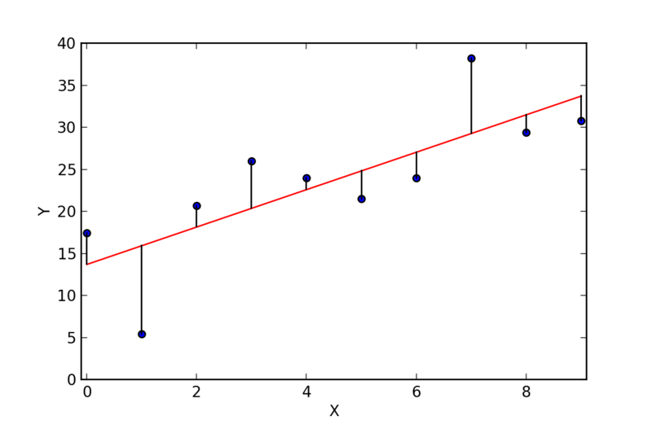
What is the Least Squares Method?
A way to find the best line through a set of points by minimizing the squared differences between actual and predicted values.
Why Use Least Squares?
Simple and effective for predicting outcomes.
Helps find the best fit line in linear regression.
by Todd Nash
Notes:
The least squares method is a statistical procedure to find the best fit for a set of data points. The method works by minimizing the sum of the offsets or residuals of points from the plotted curve. Least squares regression is used to predict the behavior of dependent variables.

Slide 3
How It Works
y = b + mx
Where:
y is the dependent variable (output).
x is the independent variable (input).
b is the y-intercept.
m is the slope of the line.
by Todd Nash
Notes:
The slope of a line is a measure of its steepness. Mathematically, slope is calculated as "rise over run" (change in y divided by change in x)
The intercept (sometimes called the “constant”) in a regression model represents the mean value of the response variable when all of the predictor variables in the model are equal to zero.

Slide 4
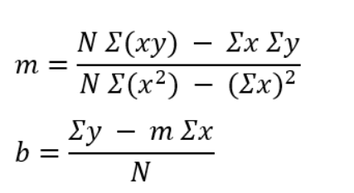
How to calculate slope (m) and intercept (b):
Where:
Σ represents a sum.
N is the number of observations.
by Todd Nash

Slide 5
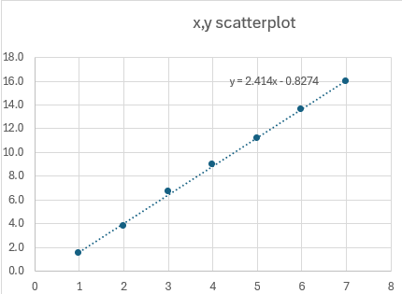
Example
x | y | xy (product) | x^2
1 | 1.50 | 1.5 | 1 | Σx = 28
2 | 3.80 | 7.6 | 4 | Σy = 61.8
3 | 6.70 | 20.1 | 9 | Σxy = 314.8
4 | 9.00 | 36 | 16 | Σx^2=140
5 | 11.20 | 56 | 25
6 | 13.60 | 81.6 | 36
7 | 16.00 | 112 | 49
28 | 61.8 | 314.8 | 140 | <-totals
x | 1 | 2 | 3 | 4 | 5 | 6 | 7
y | 1.5 | 3.8 | 6.7 | 9.0 | 11.2 | 13.6 | 16.0
by Todd Nash

Slide 6
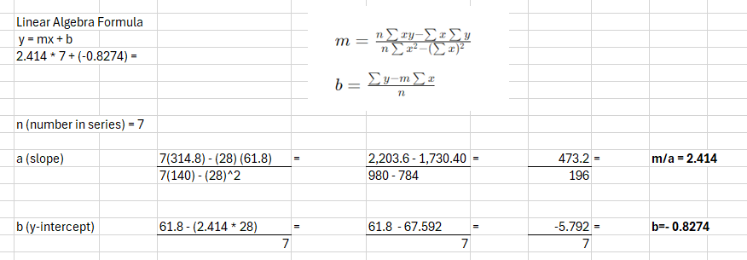
Example
by Todd Nash

Slide 7
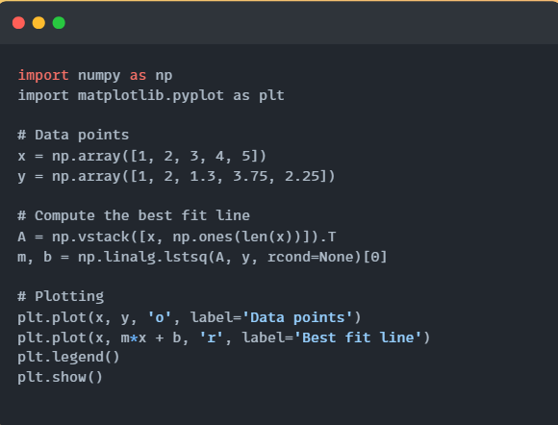
Try
by Todd Nash

Slide 8
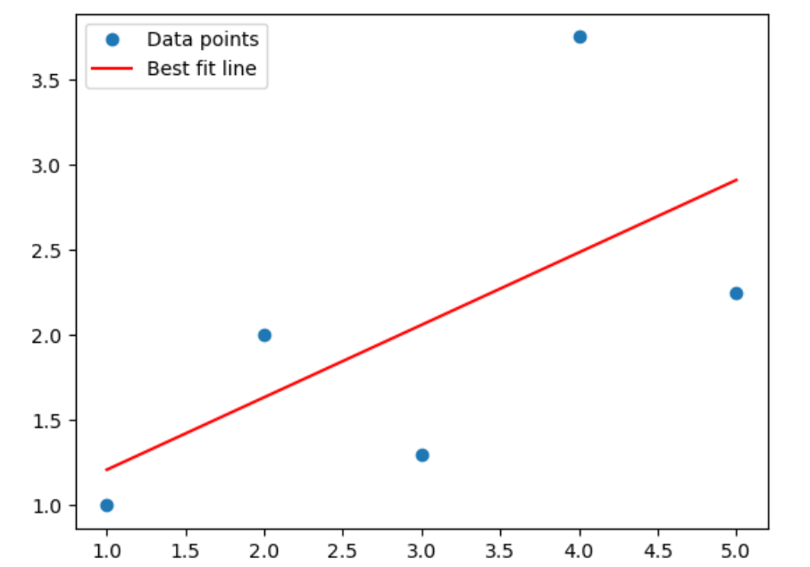
Result
by Todd Nash

